Slide 1
DDSAnalytics Talent Management
Talent Turnover Analysis
Sreeni Prabhala
Presentation Link: https://youtu.be/HE9MLaIvREk

Slide 2
What are business objectives?
Background:
Frito-Lay is always about people; it is a place that seeks out different perspectives and celebrates diversity at every level of the organization
Frito-Lay has engaged DDSAnalytics to leverage data science and take the Talent Management to next level
Scope of services includes workforce planning, employee training, and reducing/preventing voluntary employee turnover
Objectives:
Identify the top three factors that contribute to employee turnover
Build a robust model to predict attrition
Obtain job role specific insights that will help with employee retention, satisfaction, and professional development

Slide 3
What are the top factors driving attrition?
Steps:
Assess the correlation of various factor variables on attrition using appropriate plots
Assess the correlation of various continuous variables using appropriate plots
Obtain correlation coefficients for the relevant variables
Identify the set of variables that impact attrition

Slide 4
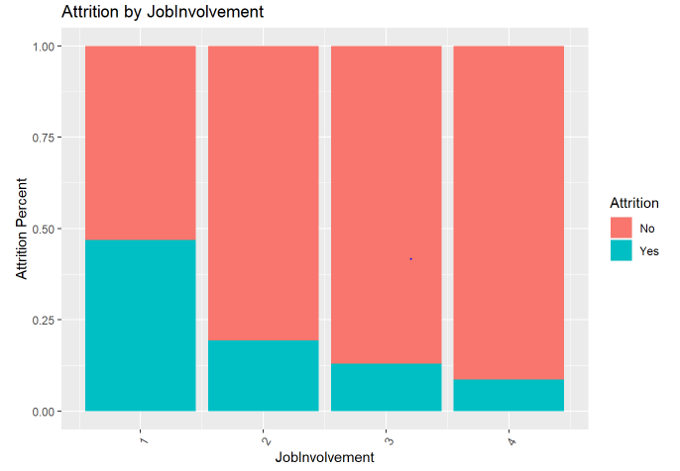
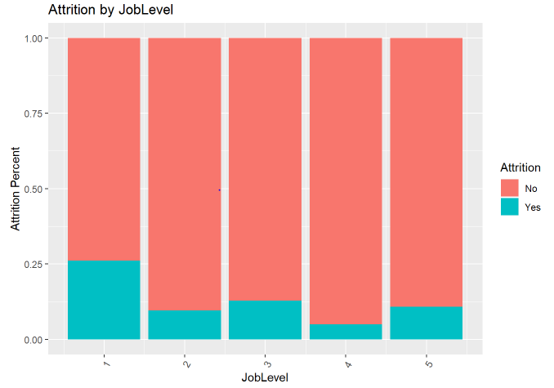
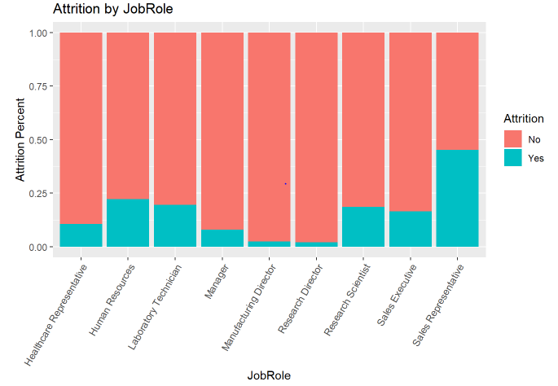
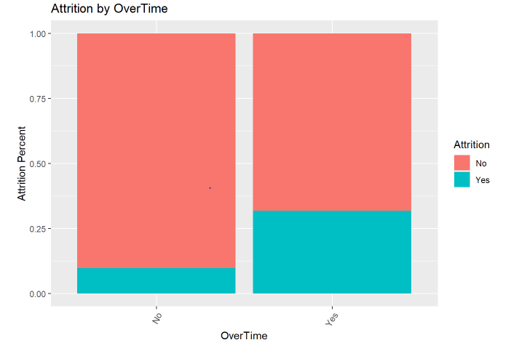
What are the top factors driving attrition?
Significant Factor Variables: EnvironmentSatisfaction, JobInvolvement, JobLevel, JobRole, MaritalStatus, OverTime, StockOptionLevel, WorkLifeBalance

Slide 5
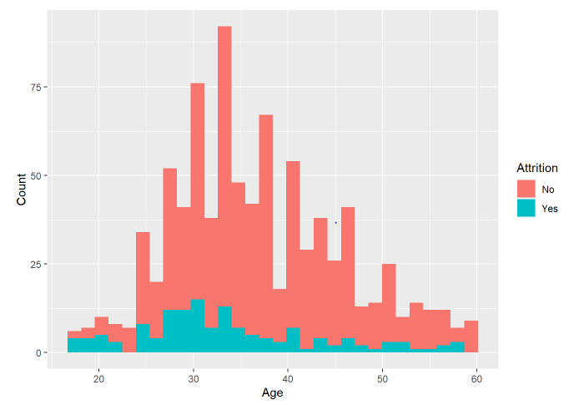
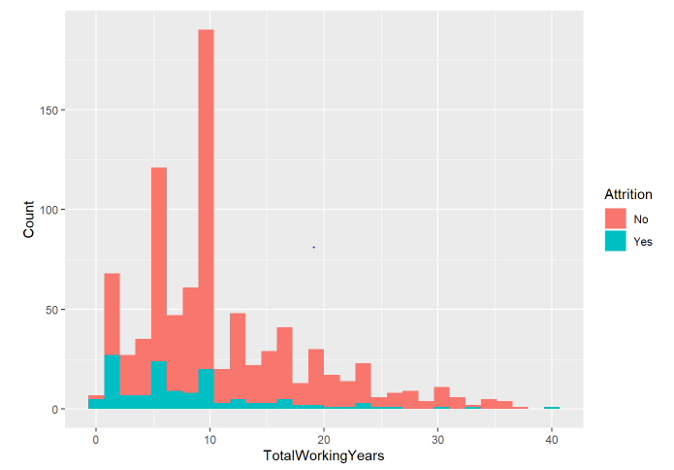
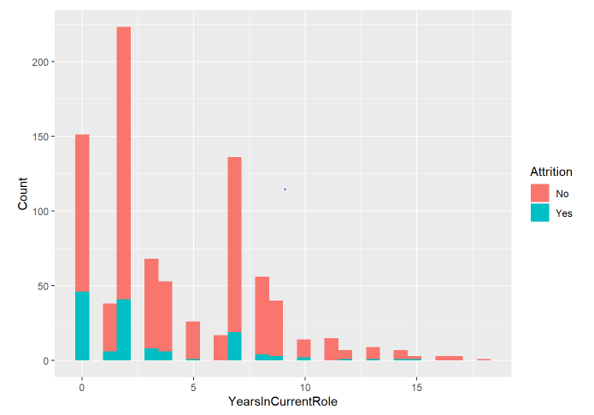
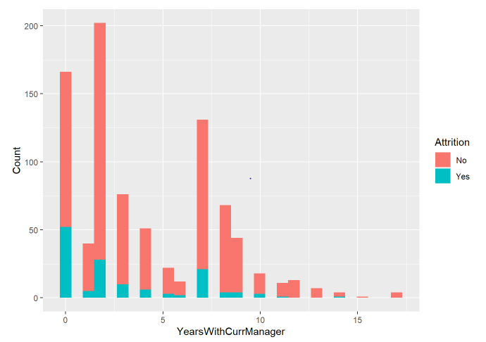
What are the top factors driving attrition?
Significant Continuous Variables: Age, TotalWorkingYears, YearsAtCompany, YearsInCurrentRole, YearsWithCurrManager

Slide 6
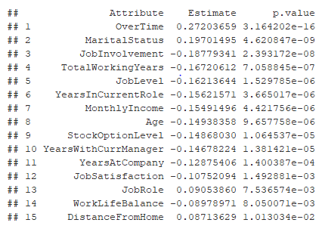
What are the top factors driving attrition?
Correlation Coefficients for Attrition
The top factors with high correlation from the above table are in general in alignment with the variables identified by examining the various plots in the previous steps.

Slide 7
What is a robust model to predict attrition?
Steps:
Build kNN and Naïve Bayes classification models using different combinations of top factors identified in the previous steps; tune hyperparameter for kNN model
Obtain mean accuracy, sensitivity, and specificity measures using multiple train-test splits for each model
Compare the above model statistics to identify the robust model for the given parameters (i.e. sensitivity > 60% and specificity > 60%)

Slide 8
What is a robust model to predict attrition?
Model Variables | Model Type | Accuracy | Sensitivity | Specificity
OverTime JobInvolvement MaritalStatus | kNN | 0.8445977 | 0.973433 | 0.1666919
 | Naïve Bayes | 0.8478927 | 0.8635297 | 0.5820551
OverTime TotalWorkingYears MaritalStatus | kNN | 0.8495785 | 0.9810056 | 0.1613805
 | Naïve Bayes | 0.8539464 | 0.8713415 | 0.6291760
OverTime YearsWithCurrManager MaritalStatus | kNN | 0.85341 | 0.9836586 | 0.1783065
 | Naïve Bayes | 0.8501533 | 0.8681159 | 0.5874116
The accuracy and sensitivity measures for all the models are good; however, kNN models do not seem to perform well when specificity is considered. Based on the analysis, a Naïve Bayes model based on OverTime, TotalWorkingYears, and MaritalStatus gives us a robust model to predict attrition.

Slide 9
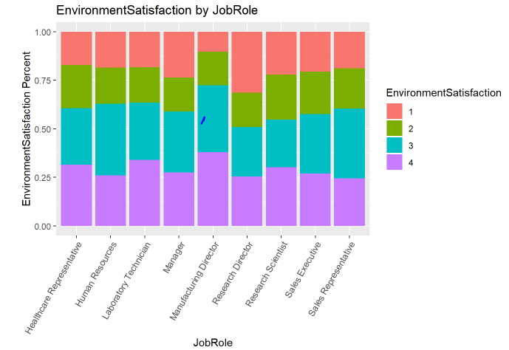
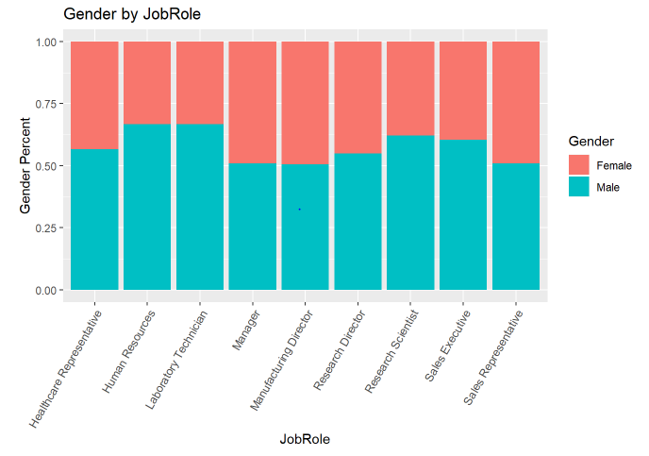
What are key insights based on Job Roles?
Employees at senior-level positions, like Managers and Directors, have reported lower levels of satisfaction
Employees at these roles may need model engagement to assess the reasons
There are opportunities to increase the gender diversity among some of the roles, like Human Resources, Laboratory Technician etc.

Slide 10
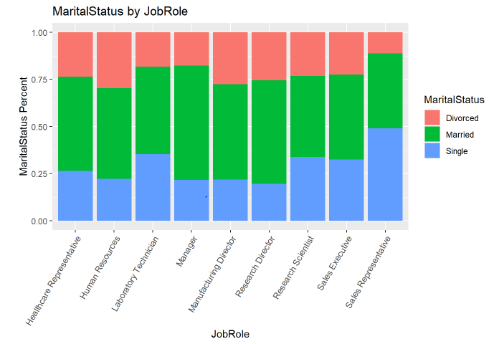
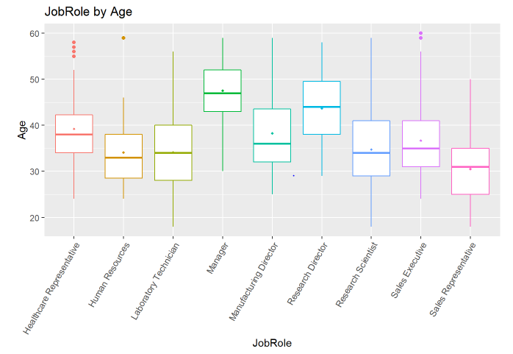
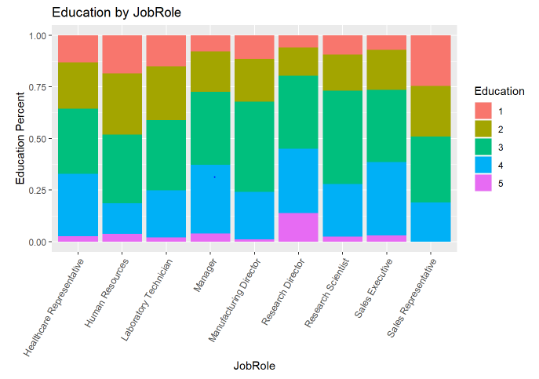
What are key insights based on Job Roles?
Sales Representatives are made up of higher number of single individuals, potentially due to their age range compared to other roles
Education levels of Sales Representatives are in general lower compared to the employees in rest of the roles

Slide 11
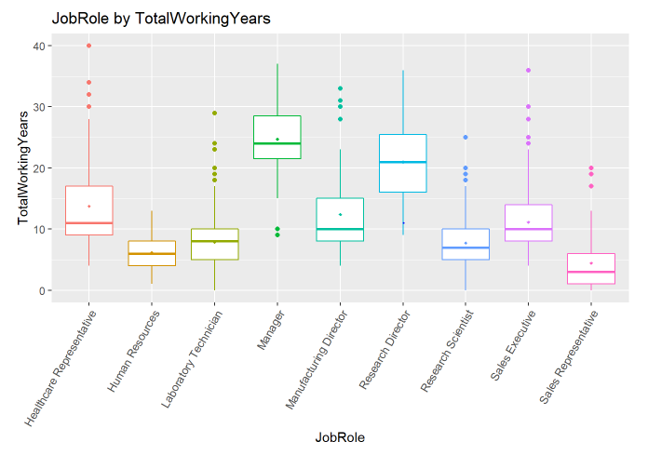
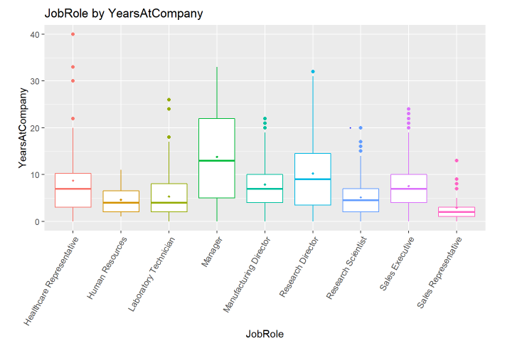
What are key insights based on Job Roles?
In general, the roles Sales Representatives, Human Resources, and Library Technicians to some extent, consist of individuals with lesser overall experience as well as tenure in the firm
Firm needs to focus on the education, training, and mentoring needs of these roles to ensure employee satisfaction and retention

Slide 12
Thank You
Sreeni Prabhala – sprabhala@smu.edu

